Slide 1
Gesture-Based Secure Authentication System Team Members: 2303A51684 2303A51062 2303A510G7 2303A51360 Department of Computer Science & Engineering

Slide 2
What is Gesture-Based Authentication?
INTRODUCTION
🔐 Overview
Traditional passwords are increasingly vulnerable to phishing, brute-force attacks, and credential theft. Gesture-based authentication leverages the unique behavioral patterns of hand movements as a biometric credential — offering a password less, liveness-aware, and user-friendly security layer.
👁️ 21 Hand Landmarks tracked per frame ⚡ 30 FPS Real-time gesture processing 🎯 82%+ Similarity score required for access

Slide 3
Project Objectives
OBJECTIVES
🤚 Gesture Capture : Capture real-time hand gestures via webcam using Media Pipe for accurate 21-landmark detection across 3 seconds.
02 🔒 Secure Registration : Register users with dual-capture gesture templates to ensure consistency. Store hashed user IDs and feature vectors in a JSON database.
03 📏 Similarity Matching Implement cosine-similarity scoring on resampled gesture frame sequences with a configurable threshold for access control.
04 🛡️ Liveness & Lockout Detect active hand presence (liveness) and lock accounts after configurable failed login attempts to prevent replay attacks.
05 👤 Multi-User Support : Support multiple user registrations with per-user hashed IDs, templates, timestamps, and an admin panel for management.
06 🖥️ Real-Time Feedback Provide on-screen progress bars, countdown timers, and similarity scores for an intuitive user experience.

Slide 4
Key Stakeholders
STAKEHOLDERS
End user
Individuals who register and authenticate using hand gestures. Benefit from password less, frictionless login experience.
Organizations
Enterprises, labs, and institutions deploying gesture auth for secure access to systems, reducing credential theft risks.
Administrators
IT admins who manage user accounts — view registered users, unlock locked accounts, and audit access logs.
Researchers
Academic researchers exploring biometric authentication, gesture recognition, and human-computer interaction.

Slide 5
Programming Languages, Tools & Software
TECHNOLOGIES
🐍
LANGUAGE
Python 3.x
Core programming language. Object-oriented, modular code structure.
🖐️
ML LIBRARY
Media Pipe
Google's ML framework for real-time hand landmark detection (21 points).
🔢
NUMERICS
NumPy
Cosine similarity calculations, array operations, feature normalization.
💾
STORAGE
JSON / hash lib
User database persistence with SHA-256 hashed usernames for privacy.

Slide 6
Prompts Used to Generate Code (1/2)
AI PROMPTS
P1 System Design
"Build a gesture-based authentication system in Python using Media Pipe Hands and OpenCV. Include user registration, login with cosine similarity matching, and a JSON database. Capture 3 seconds of hand gesture per session and normalize landmarks relative to the wrist."
P2 Feature Extraction
"Write a Python function that takes a Media Pipe hand landmarks object and returns a normalized 63-dimensional feature vector. Normalize relative to wrist position and scale by the wrist-to-middle-MCP distance for translation and size invariance."
P3 Similarity Algorithm
"Implement a gesture similarity() function that computes mean cosine similarity between two variable-length sequences of landmark feature vectors using frame resampling to 30 reference points. Return a float in [0,1]."

Slide 7
Prompts Used to Generate Code (2/2)
AI PROMPTS
P4 Dual Registration
"Modify the register() function to capture the gesture twice and compute a consistency score. If the score is below 0.75, reject registration. Store both captures as primary and secondary templates in the database."
P5 Lockout Logic
"Add a failed-attempt counter and account lockout mechanism. After 3 failed login attempts, mark the user account as locked in the JSON database. Provide an admin unlock user() function to reset the counter and unlock the account."
P6 UI Overlay
"Enhance the OpenCV capture window with: a semi-transparent header bar showing the current prompt, a real-time progress bar filling from left to right over 3 seconds, a countdown timer in the lower left, and color-coded status text for hand detected vs not detected states."
7

Slide 8
Prompts Used to Generate Code (3/2)
AI PROMPTS
P7 Admin Panel
"Create a list users() CLI admin function that prints a formatted table of all registered users showing: username, registration datetime, failed attempt count, and account status (Active / LOCKED) using emoji indicators."

Slide 9
System Workflow Flowchart
SYSTEM WORKFLOW
REGISTRATION FLOW
LOGIN FLOW
👤 Enter Username
👤 Enter Username
🤚 Capture Gesture (1/2)
🔍 Lookup User in DB
🔁 Capture Gesture (2/2)
🤚 Capture Live Gesture
📊 Consistency Check ≥ 0.75?
📏 Cosine Similarity Score
💾 Save to JSON Database
✅ Score ≥ 0.82 → ACCESS GRANTED
❌ Fail → Retry / Lockout after 3 attempts

Slide 10
Application User Interface
UI / FRONTEND VIEW
🟢 Hand Detected Overlay
Landmark skeleton + connection lines drawn in real-time on the video feed using mp_drawing utilities.
Gesture Auth — LOGIN — Show your gesture
📊 Progress Bar
Bottom bar fills over 3 seconds while gesture is held, showing capture completion.
⏱️ Countdown Timer
Live countdown displayed bottom-left: 'Hold still: X.Xs' in green.
Hold still: 1.2s
🔢 Similarity Score
Similarity: 0.871 (threshold: 0.82)
After capture, score is printed to console: 'Similarity score: 0.871 (threshold: 0.820)'.

Slide 11
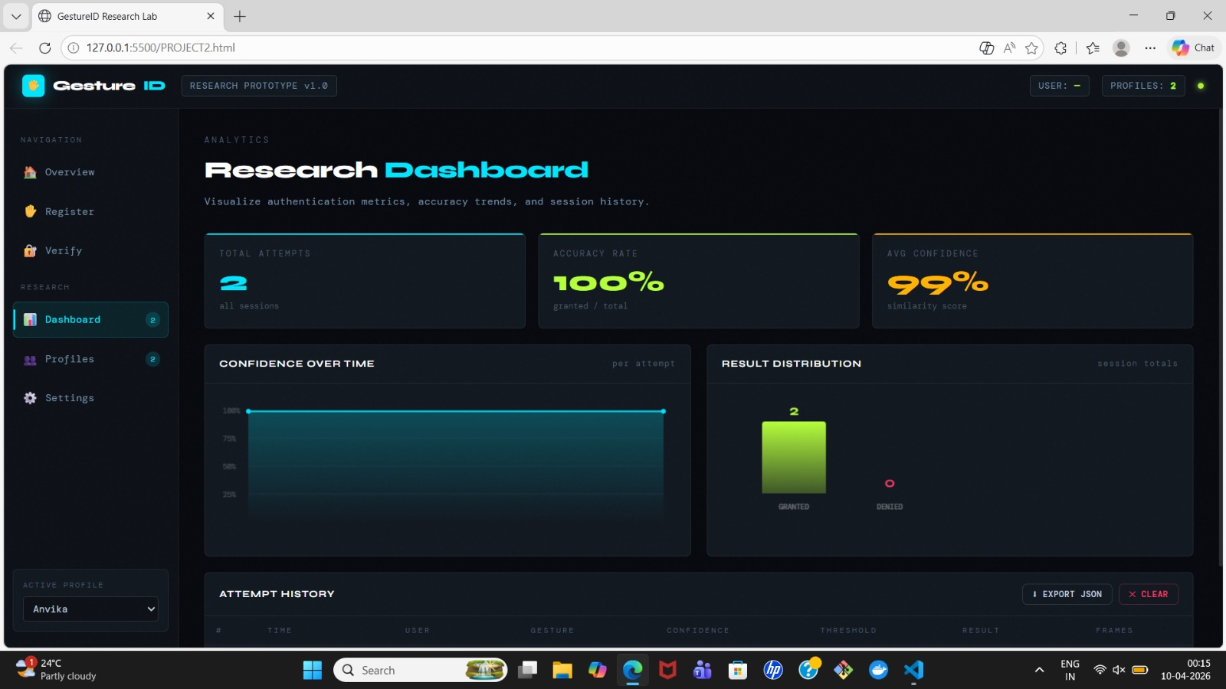
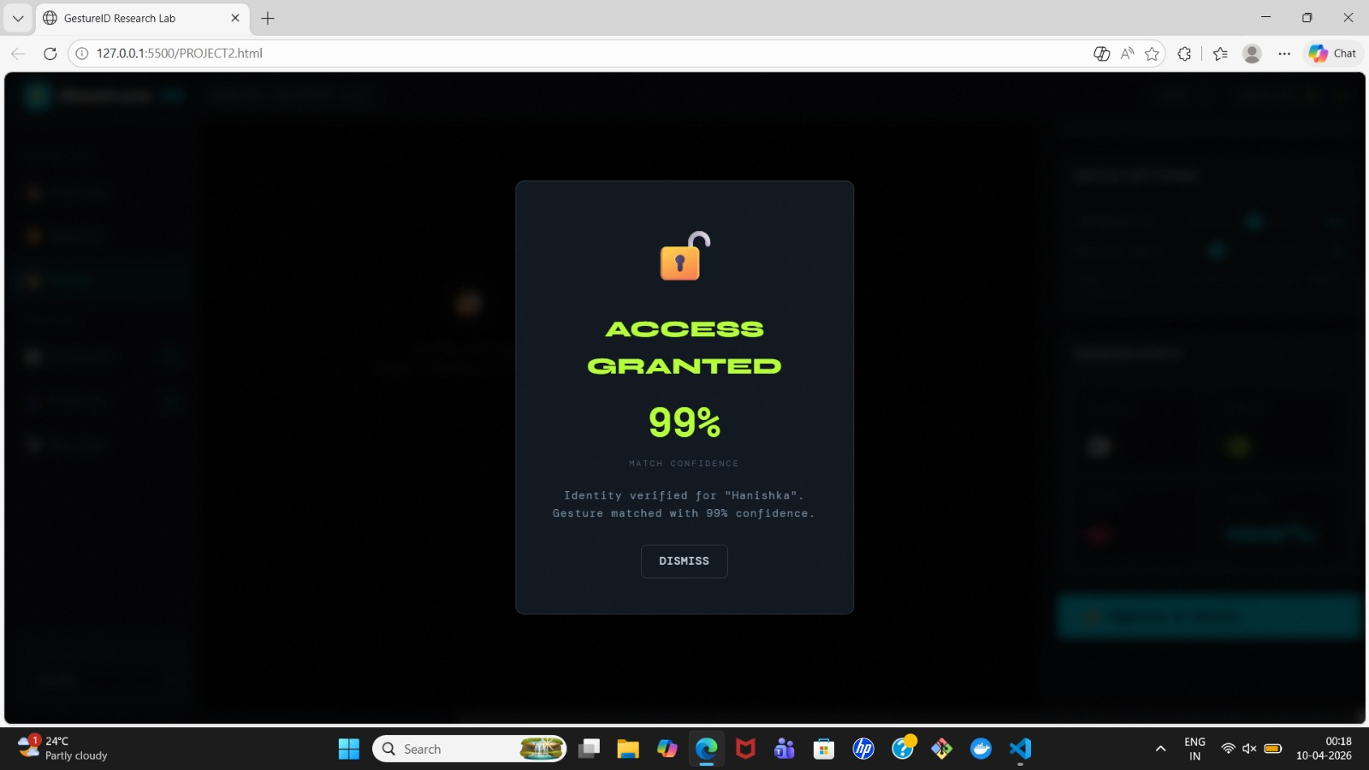

Slide 12
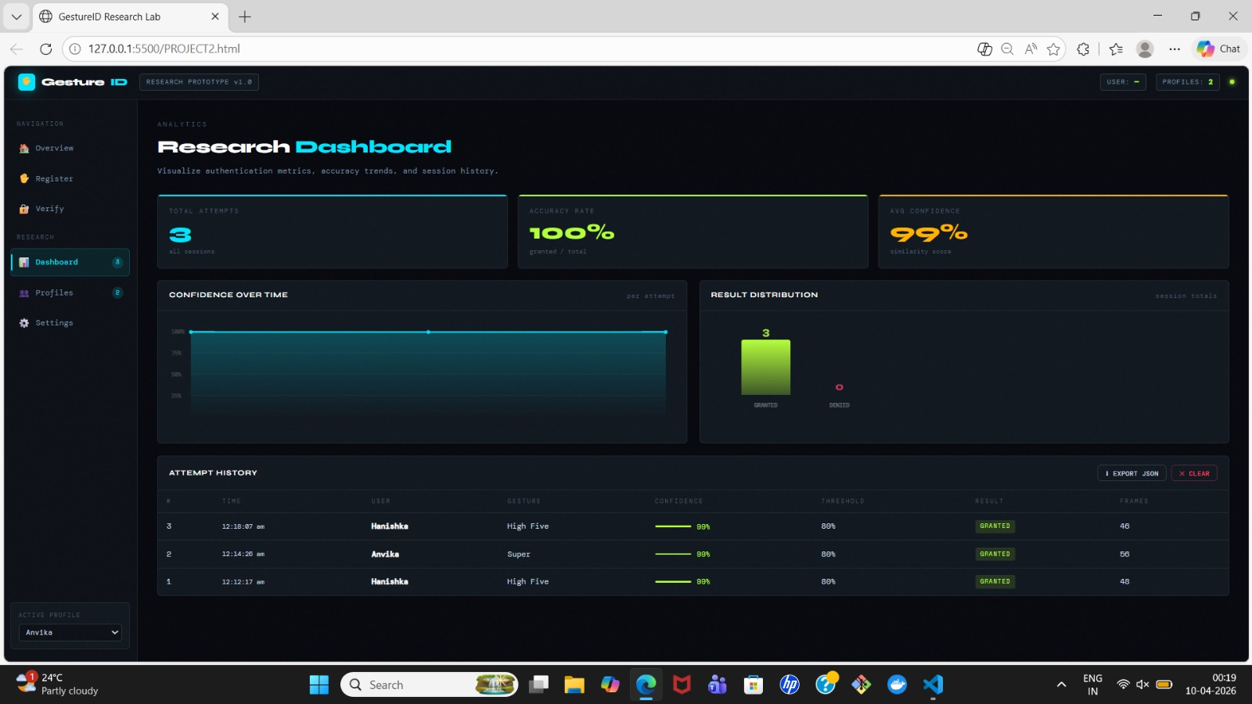
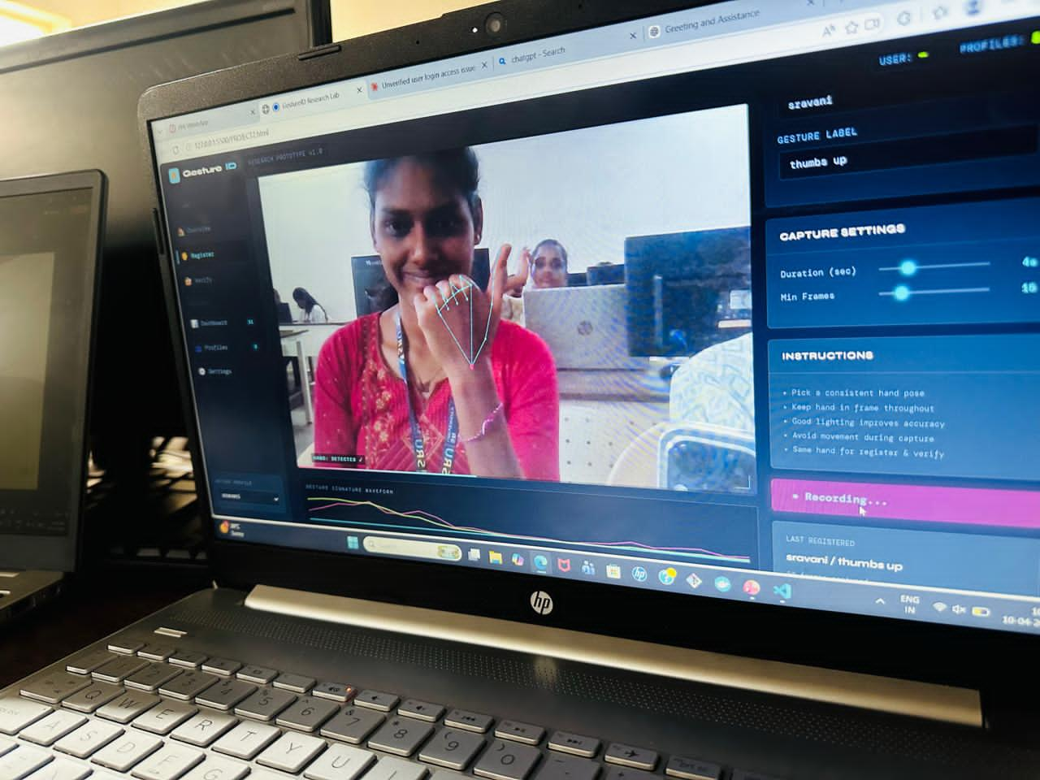

Slide 13
References
[1]
Google MediaPipe Team. MediaPipe Hands: On-device Real-time Hand Tracking. Google AI Blog, 2020. https://ai.google.dev/edge/mediapipe/solutions/vision/hand_landmarker
[2]
Bradski, G. (2000). The OpenCV Library. Dr. Dobb's Journal of Software Tools. https://opencv.org
[3]
Harris, C.R., et al. Array programming with NumPy. Nature, 585, 357–362, 2020. https://numpy.org
[4]
Python Software Foundation. Python 3 Documentation. https://docs.python.org/3/
[5]
Mane, S., et al. Gesture-Based Authentication Using Hand Landmarks and Machine Learning. IJCSIT, 2022.
[6]
National Institute of Standards and Technology (NIST). Digital Identity Guidelines (SP 800-63B), 2020. https://pages.nist.gov/800-63-3/
[7]
OpenAI / Anthropic Claude. AI-assisted code generation prompts and responses. [AI Tool used in this project]
Gesture-Based Secure Authentication System | Department of Computer Science & Engineering

Slide 14
thank you

